Slide 1
Chapter 2
Instructions: Language of the Computer
Notes:
The University of Adelaide, School of Computer Science
Chapter 2 — Instructions: Language of the Computer

Slide 2
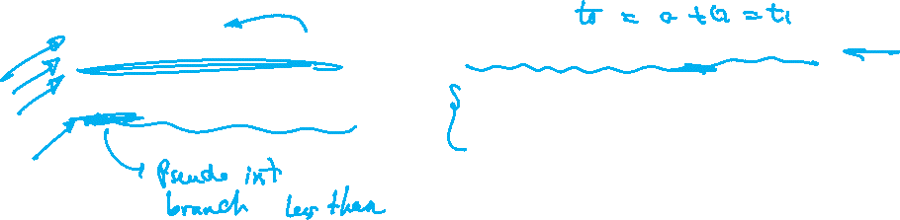
Assembler Pseudo-instructions
Most assembler instructions represent machine instructions one-to-one
Pseudo-instructions:
  need encoding from the assembler
  makes coding easier for the programmer
move $t0, $t1 → add $t0, $zero, $t1
blt $t0, $t1, L → slt $at, $t0, $t1
bne $at, $zero, L
Chapter 2 — Instructions: Language of the Computer — <number>

Slide 3
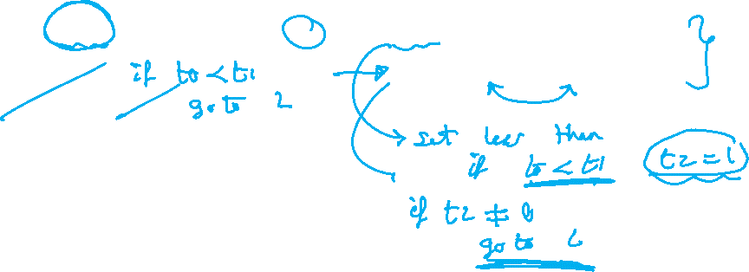
Assembler Pseudo-instructions
Branching is easier with Pseudo-instructions
blt replaces two instructions to perform a branch
blt $t0, $t1, L → slt $t2, $t0, $t1
bne $t2, $zero, L
Chapter 2 — Instructions: Language of the Computer — <number>

Slide 4
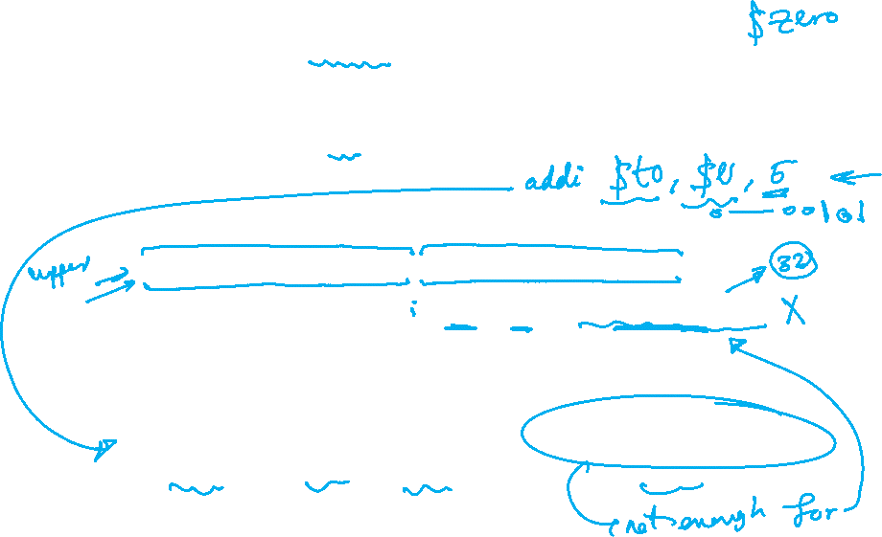
Assembler Pseudo-instructions
How to store 32 bit immediate value in a register? → That needs two instructions
Although with li pseudo-instruction we can code it in one simple line
  Example load $t0 with 4042326015_{ten} = 11110000111100001111111111111111_{bin}
  We cannot use add $t0,$0, 4042326015
  The immediate value in I format must be <= 16-bits
op
rs
rt
constant or address
6 bits
5 bits
5 bits
16 bits
Chapter 2 — Instructions: Language of the Computer — <number>
Notes:
The University of Adelaide, School of Computer Science
Chapter 2 — Instructions: Language of the Computer

Slide 5
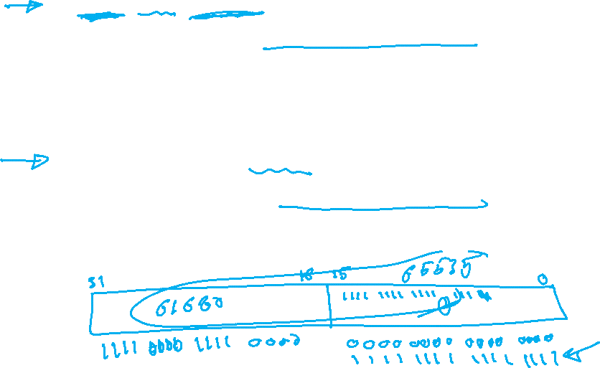
Assembler Pseudo-instructions
The solution is to do that in two steps
  lui $t0,61680 # step 1
  # 61680_{ten} = 1111000011110000_{bin}
  Lui will set bits 16 to 31 of $t0 to 1111000011110000 and bits 0 to 15 will be 0000000000000000_{bin}
  Ori $t0,$t0,65535 # step 2
  # 65535ten = 1111111111111111_{bin}
  Step 2 will set bits 0 to 15 to 1111111111111111_{bin}
Chapter 2 — Instructions: Language of the Computer — <number>

Slide 6

Assembler Pseudo-instructions
The Pseudo-instructions li can do the same job in one line
li $t0, 4042326015
The assembler will decode this pseudo instruction into the two instructions explained in the previous slide
li $t0, 4042326015 → lui $t0,61680
Ori $t0,$t0,65535
Chapter 2 — Instructions: Language of the Computer — <number>

Slide 7

Pseudo-instructions – Appendix A
abs rdest, rsrc
div rdest, rsrc1, src2
divu rdest, rsrc1, src2
mulo rdest, rsrc1, src2
mulou rdest, rsrc1, src2
neg rdest, rsrc
negu rdest, rsrc
not rdest, rsrc
rem rdest, rsrc1, rsrc2
remu rdest, rsrc1, rsrc2
rol rdest, rsrc1, rsrc2
ror rdest, rsrc1, rsrc2
li rdest, imm
seq rdest, rsrc1, rsrc2
sge rdest, rsrc1, rsrc2
sgeu rdest, rsrc1, rsrc2
sgt rdest, rsrc1, rsrc2.
sle rdest, rsrc1, rsrc2
sleu rdest, rsrc1, rsrc2
sne rdest, rsrc1, rsrc2
b label
beqz rsrc, label
bge rsrc1, rsrc2, label
bgeu rsrc1, rsrc2, label
bgt rsrc1, src2, label
bgtu rsrc1, src2, label
ble rsrc1, src2, label
bleu rsrc1, src2, label
blt rsrc1, rsrc2, label
bltu rsrc1, rsrc2, label
bnez rsrc, label
la rdest, address
ld rdest, address
ulh rdest, address
ulhu rdest, address
ulw rdest, address
sd rsrc, address
ush rsrc, address
usw rsrc, address
move rdest, rsrc
mfc1.d rdest, frsrc1
l.d fdest, address
l.s fdest, address
s.d fdest, address
s.s fdest, address
Chapter 2 — Instructions: Language of the Computer — <number>

